Slide 1
Detecting exoplanets
May 11th, 2017
Radial velocity method
Kunal Tambekar | Nikhil Paratkar

Slide 2
AGENDA
PROBLEM STATEMENT
INTRODUCTION
PROBLEM FORMULATION
DATA
SOLUTION
EVALUATION
CONCLUSION

Slide 3
PROBLEM STATEMENT
Given data on radial velocities of stars over time, we want to develop a system that detects candidate stars for possible orbiting exoplanets around them.

Slide 4
INTRODUCTION
Doppler spectroscopy
Radial velocity
Redshift and blueshift

Slide 5
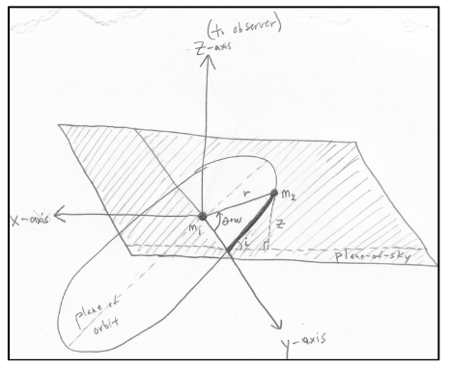
PROBLEM FORMULATION
ASSUMPTIONS:
Orbits are circular
Eccentricity e = 0
Stars will have only one planet orbiting it
Orbital plane is parallel to our line of sight
Making the value of Sin(i) = 1, where i is the angle mage by observer and the orbital plane

Slide 6
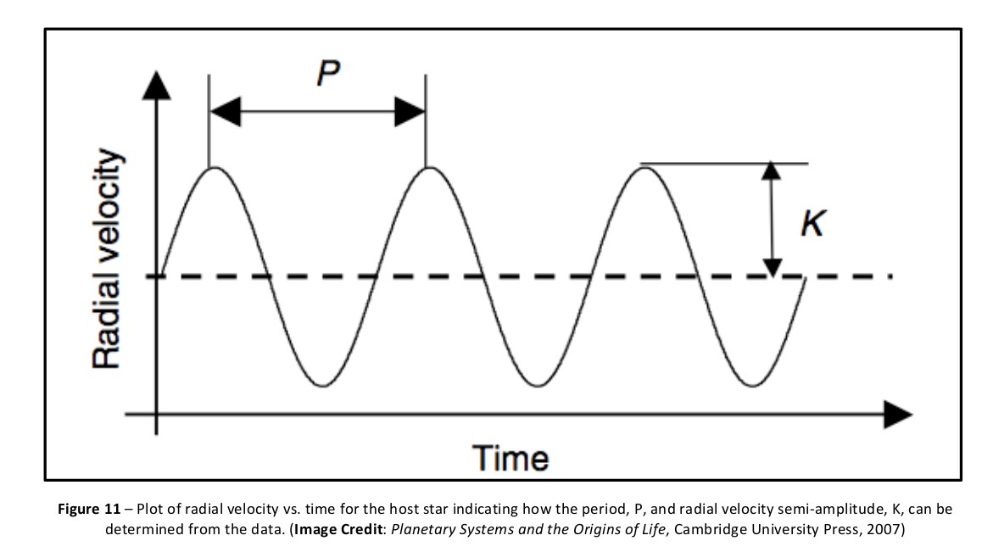

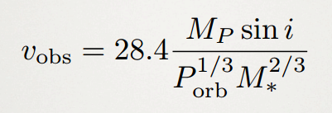
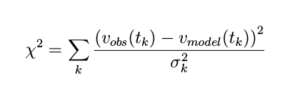
PROBLEM FORMULATION
Plotting Radial velocities against Time K : star’s radial velocity semi‐amplitude P : Time period of the star system ( t - t₀) : Time from time series v₀ : Considered 0

Slide 7
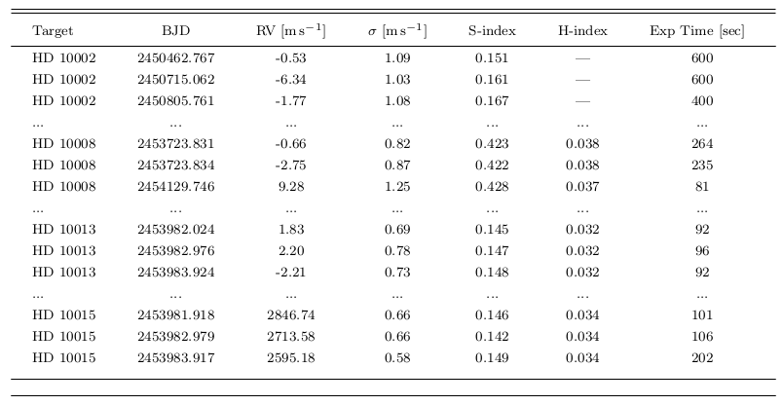
DATA

Slide 8
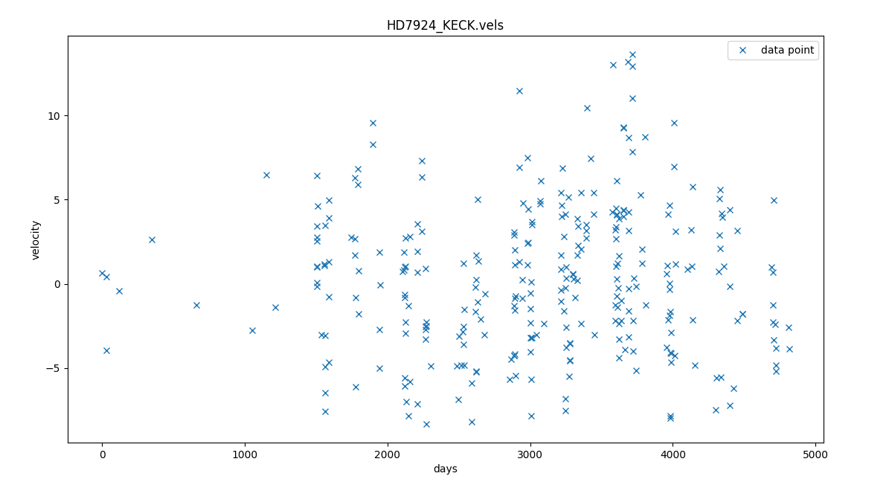
DATA

Slide 9
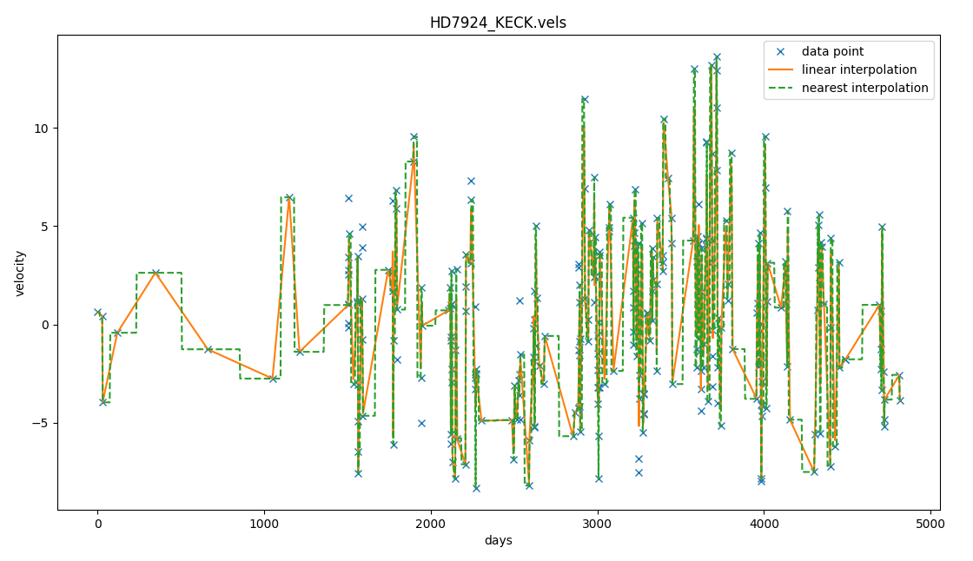
SOLUTION
Interpolation

Slide 10
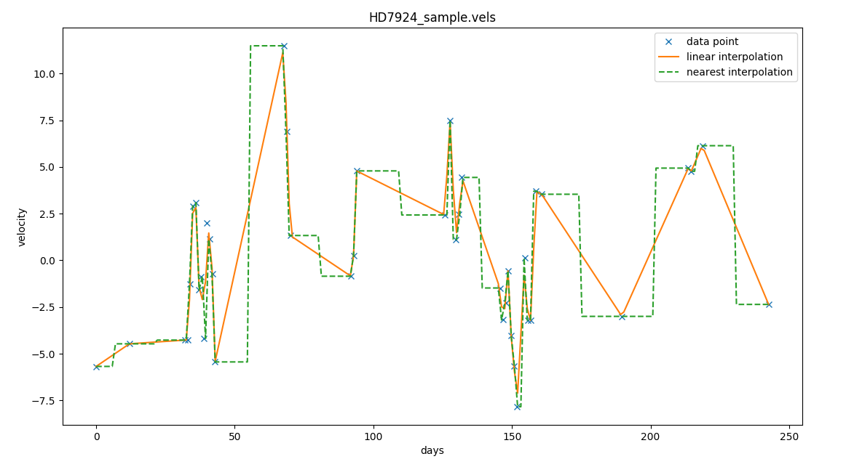
SOLUTION
Selecting smaller dataset

Slide 11
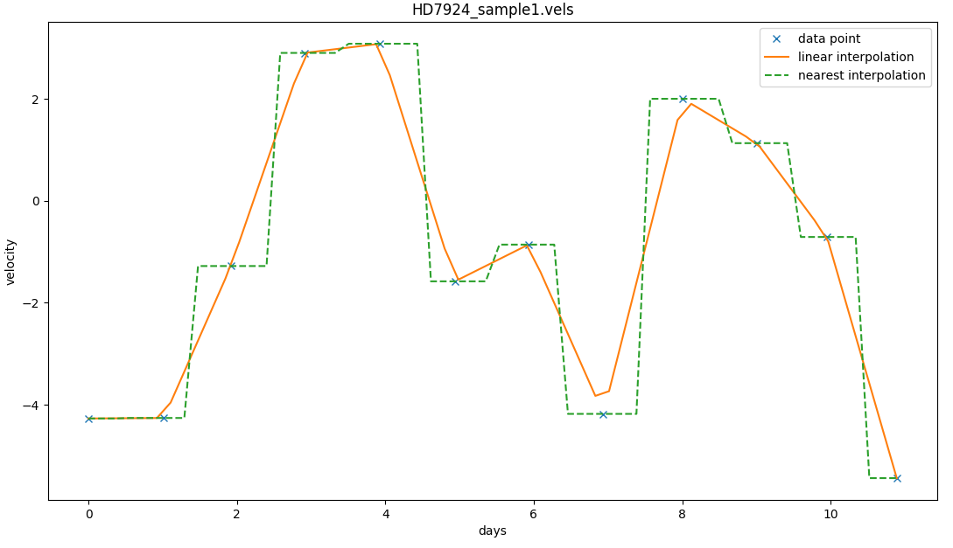
SOLUTION
Selecting evenly spaced consecutive data-points

Slide 12
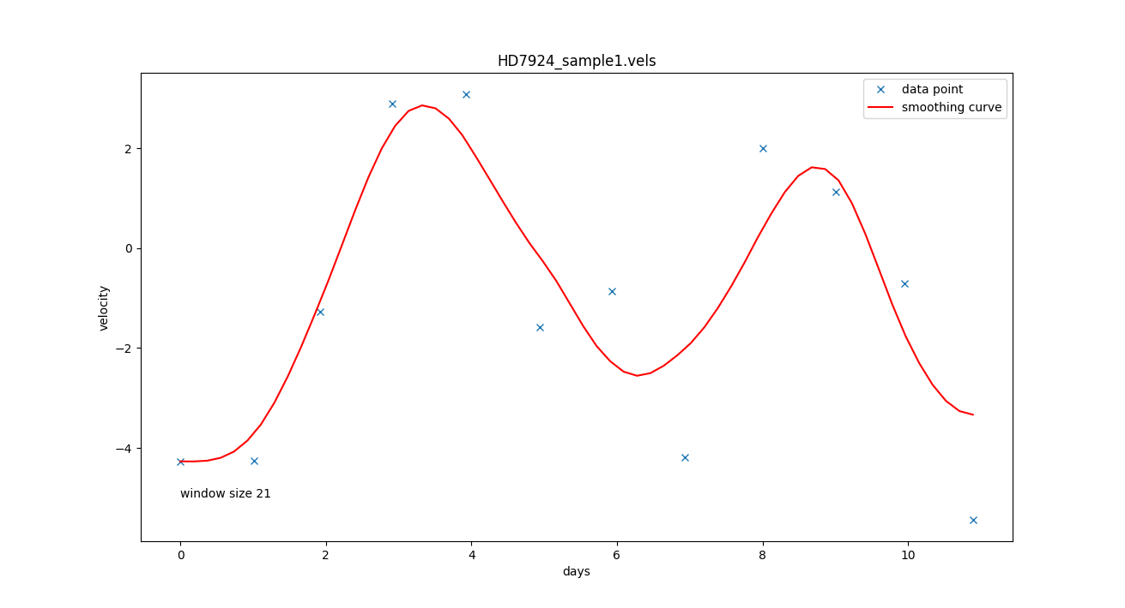
SOLUTION
Smoothing
(Savitzky golay digital filter for smoothing)

Slide 13
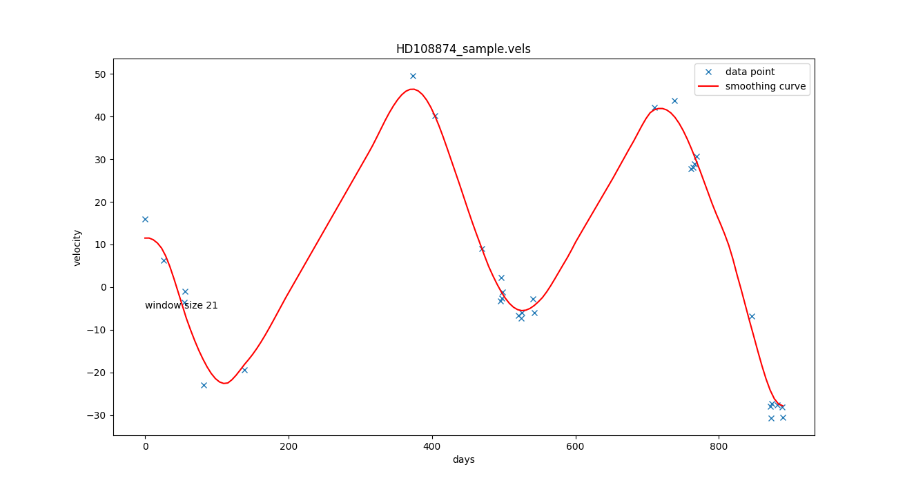
SOLUTION
Smoothing

Slide 14
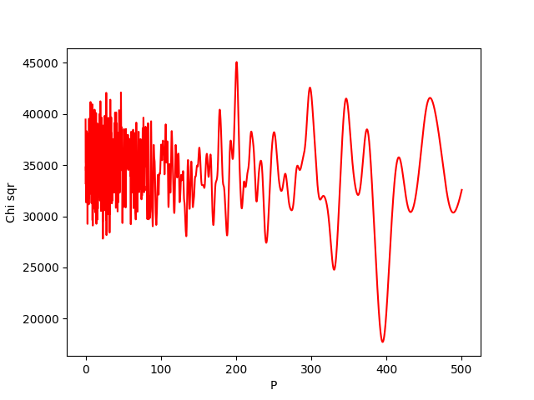
EVALUATION
By minimizing χ² the guessed values approach the maximum likelihood estimate of the orbital parameters.
HD108874
P = 394.78

Slide 15
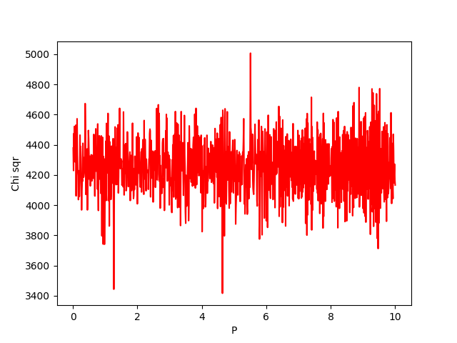
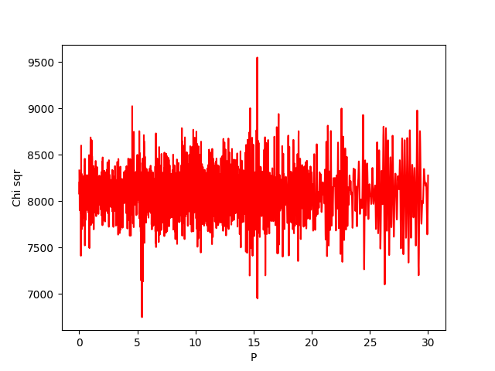
EVALUATION
HD156668
P = 4.65 days
HD9724
P = 5.3979

Slide 16
CONCLUSIONS
Given radial velocity data, we were able to apply different techniques of interpolation and curve smoothing to get a value of orbital period of a planet orbiting the given star.
Using this estimated value of orbital period, we were able to apply a function to approach the maximum likelihood estimate of the orbital parameters.
To further confirm the presence of an exoplanet, we need additional data on the star’s mass(calculated using luminosity) and angle of inclination between the orbital plane and the observer.
Different approaches are needed to confirm the existence of a multi-planet system.

Slide 17
Thank you

